Slide 1

Ysgol Rhos Helyg
Nurture, Grow, Achieve

Slide 2
Designing Our Curriculum at Ysgol RhosHelyg
In consultation with all of our stakeholders we have designed our curriculum through a series of steps.
Vision and Values – We have established the purpose of our curriculum through identifying our school’s unique factors, our vision and our values. We involved all stakeholders in determining these key principles.
Developing our Learner Offer – We decided on what a typical learner will have experienced on their journey through our school and the skills they will have developed in different contexts. This helped us to decide on our offer, including our non-negotiables and enhancement experiences.
Curriculum Content – We used this information to shape what a typical school year will look like, including the broad range of experiences, knowledge and skills. They will be explored through a range of authentic contexts which have been collated using the Descriptions of Learning, Pupil Voice and stakeholder views. We have also ensured links across all areas to enable depth of learning over time.
Curriculum Delivery – In consultation with all stakeholders we have sought to explore the ‘why’, ‘what’ and ‘how’ of our curriculum to ensure that the vision and values are being realised through curriculum planning and delivery. The learning environment is integral to support effective learning and teaching to aid exploration and independent thinking and learning.
Progression and Assessment – Learner progression across the 3-16 continuum is integral to our curriculum and using the Principles of Progression, we assess and track learners enabling them to make progress and to ensure they receive the correct support and challenge. We have also implemented the new AEN Code of Practice to support all learners in an inclusive curriculum.
Review and Evaluate – Once established our curriculum will be reviewed for its impact on learning, teaching and engagement and in its effectiveness in realising our vision. We will make any necessary adaptations as well as consider any further professional development for teachers and governors.

Slide 3

Ysgol Rhos Helyg Curriculum Rationale
Our Vision and Values
Together we will:
Support our pupils to become aspirational, resilient and lifelong learners who are equipped for the future and prepared to enter the world of work.
Instill in them a pride in their identity and a respect for others in a nurturing and supportive environment where everyone’s needs are recognised and valued.
Enable our learners to be productive members of their community and to become global citizens who respect the environment and are able to connect and contribute to world around them.
Teach our learners to be healthy and active in their lives and to express themselves in different ways.

Slide 4
Ysgol Rhos Helyg is located on Halkyn Mountain. The rural location is ideal for fostering a love of the environment and outdoor learning which is at the heart of our curriculum. As a rural school, we also want our pupils to learn about the wider world beyond their community and ensure that there is also a strong global element to their learning. Our educational philosophy is based on inclusion, health and wellbeing ensuring that all our pupils achieve their best and are supported to become happy and independent learners.
Our Values | Our behaviours
Kindness | At our school we think that kindness is one of our most important values. We aim to create a nurturing school community where everyone is treated with care, fairness and respect.
Respect | We foster an environment where respect is shown for the beliefs, cultures and needs of others as well as for the environment both local and global. We listen to each other and make time to talk.
Ambition | We work hard on developing our skills and in being resilient learners with a positive growth mindset. We are motivated to learn and aim high.
Co-operation | We work together as a team to achieve our goals and to make our school community a place where we can succeed. We work together to sort out our differences and we work with each other to solve problems.
Health | We support everyone’s well-being needs to ensure that everyone is able to learn to their full potential and are supported in every way. We promote the importance of a healthy lifestyle and how this impacts on learning.
Creativity | We encourage all our learners to explore and learn creatively and to develop their entrepreneurial skills.
Curiosity | We support our learners to develop a love of learning, to influence what they learn and to ask questions about the world around them.
Inclusivity | Through a person-centred approach we want everyone to be able to take a full and active part in school life.

Slide 5
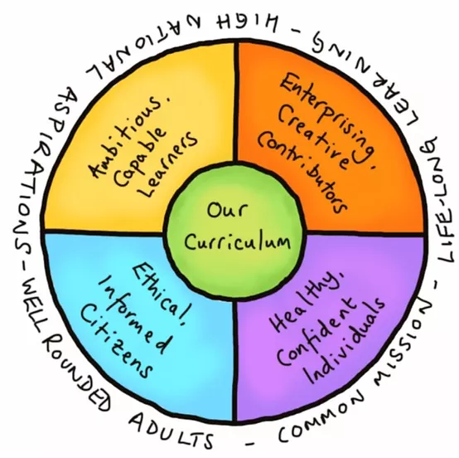
Curriculum at Rhos Helyg

Slide 6
What do we mean by Curriculum ?
Our curriculum is the means by which we realise our Vision and Values and in
ensuring our learners become ambitious, enterprising, ethical and healthy citizens of the world.
It is broad and balanced and suitable for all our learners whatever their age, ability and aptitude.
It provides opportunity for depth and breadth of learning and for progression from learners’ starting points.
Why do we teach it?
To provide high quality and authentic , real-life learning experiences which motivate and excite our learners. In doing so we aim to realise our Vision and Values.
How do we Teach?
In facilitating the learning, school staff will use all they know about each pupil to design experiences that are engaging, challenging and progressive. Pupils will have opportunity to influence their learning and to follow their interests. They will learn in an environment which is stimulating and which fosters independence and creative thinking.
At Rhos Helyg, our curriculum is based on the 6 Areas of Learning which encompass the Statements of What Matters . Pupils progress along a continuum which reflects the Principles of Progression. Our curriculum includes the required Cross-Curricular Skills and Mandatory Elements.

Slide 7
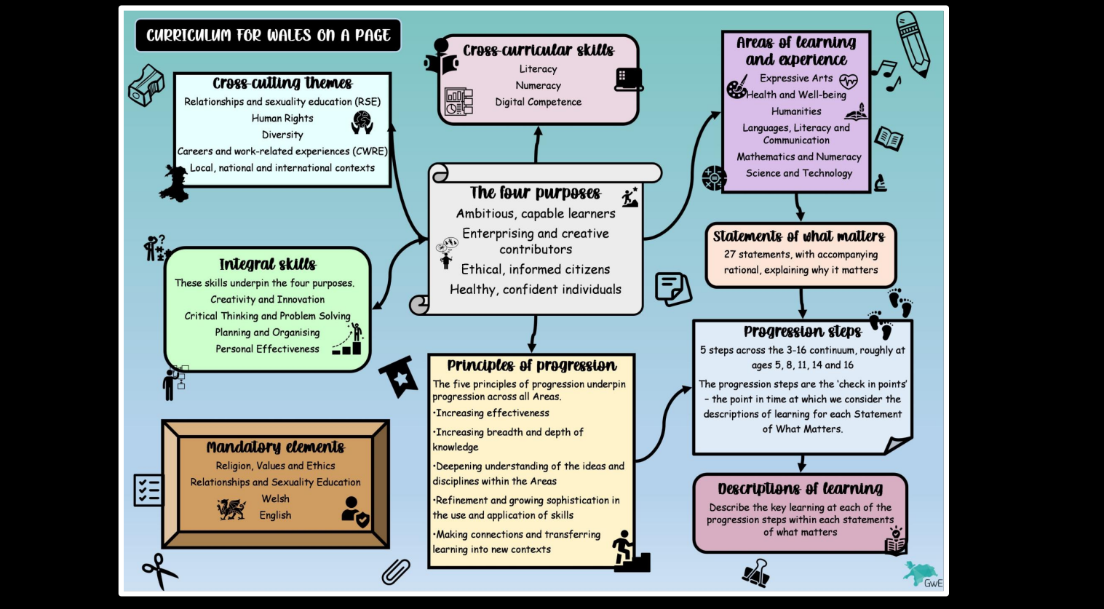

Slide 8
At Ysgol Rhos Helyg we aim to enrich the curriculum with opportunities that make learning exciting, memorable and real. Our non-negotiables offer experiences and enhancements to which each learner is entitled.
Outdoor Education: Our extensive Outdoor Education programme provides learners with an opportunity to be active and learn in a way that promotes health and wellbeing. This includes Forest Schools, Gardening, exploring the mountain environment and Adventurous Activities.
Health and Wellbeing: We promote 5 Ways to wellbeing through all aspects of our curriculum and provide nurture sessions for learners who are in need of support. This includes Forest Friends, Rainbows and Morning Nurture.
Creative Curriculum: We provide extensive opportunities for our learners to work with artists, poets and authors. We also provide opportunities for performance through Drama for Education, Young Voices/Amasing, Urdd Eisteddfod and school shows.
Non-Negotiables at Rhos Helyg

Slide 9
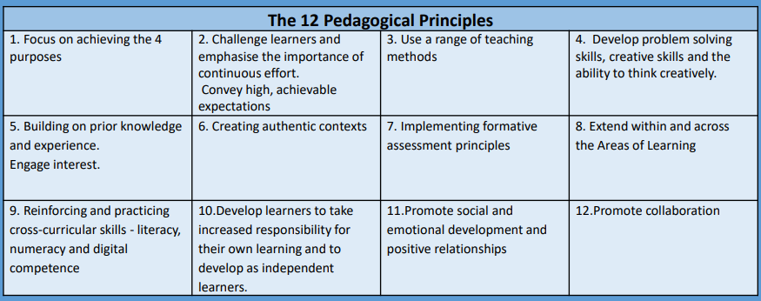
Delivering Our Curriculum
We will ensure that we deliver a high-quality curriculum in a stimulating environment where our pupils become curious and motivated learners.
Through direct teaching disciplinary and multidisciplinary approaches will be used learn and practice specific skills e.g. maths skills, phonics
Interdisciplinary and integrated approaches are used to practice and apply skills in different cross curricular contexts. e.g. draw on elements of Maths, Language, Digital Competence and Humanities when researching and writing a report comparing weather in Wales and Italy.
Most of the learning experiences in our school are designed around a termly theme or Big Question based on a lead area of learning. At the beginning of each term, pupils will play a central part in influencing their own learning through shared planning sessions and will continue to collaborate through the term to co-plan their area challenges.
Pupils will work as a whole class and in specific learning areas, continuing the Foundation Phase practice into KS2 when appropriate.
We will base our teaching practice on the 12 Pedagogical Principles and on proven quality research-based practice.

Slide 10


Slide 11
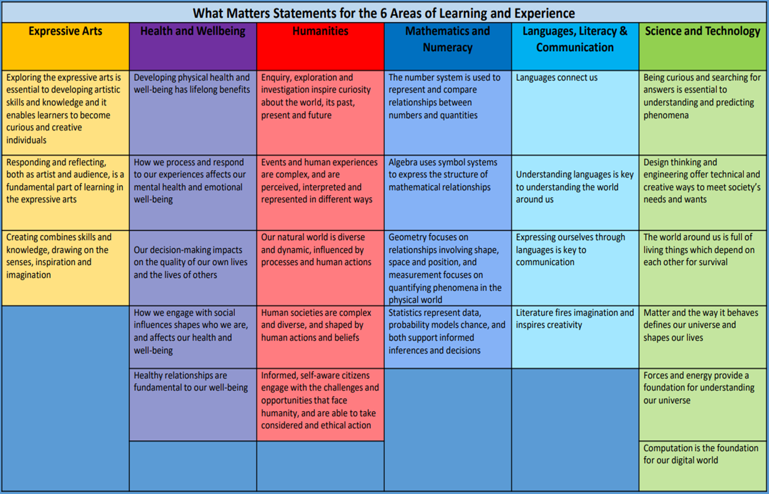
Planning
Emphasis is placed on planning a range of learning experiences , knowledge and skills based on the 6 Areas of Learning and Statements of What Matters.
These are explored through a range of authentic contexts, special topic weeks and topics based on the interests of our learners and the need of our community.
Learning opportunities will frequently combine and make links across the different areas as well as include the mandatory elements, cross-cutting themes and cross-curricular skills.
Learning experiences will be broad and deep to ensure that learners have time to acquire, practice and apply skills over time.

Slide 12
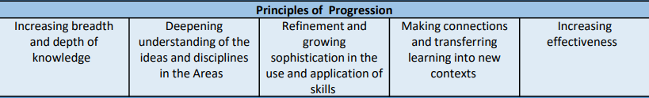
Progression and Assessment
We use the Descriptions of Learning for each What Matters Statement to assess and plan for learners' progress. These broadly correspond to expectations for ages 5, 8, 11, 14 and 16 and offer guidance on how learners should demonstrate progress within each Statement. These are used as tools to consider when planning next steps in learning. In addition, there are Principles of Progression that underpin our planning for learners' progress over time.
We will utilise various assessment methods to support each learner and to ensure they are making progress at an appropriate pace. Assessments will be fundamental in ensuring that each learner is supported and challenged and that their needs and next steps are identified.
We will assess on a day-to-day basis (Assessment for Learning) to identify and capture the progress each learner is making over time.
We will also assess and monitor each learner’s wellbeing (PASS) and cognitive development (CATs) and gather information from parents for One-Page-Profiles which will help us support learners more effectively.
We will complete Online Assessments as a way of gathering summative data for each learner.
We will track progress using the Taith 360 system.

Slide 13
Communicating and Engaging with Parents
Parental involvement is of paramount importance to ensure the wellbeing and success of each of our pupils. We seek the views of parents in all aspects of curriculum design and delivery and ensure on-going involvement in a variety of ways. Effective communication is a way to help parents understand how best to support and be a partner in their child’s learning journey.
One page Profiles – At the beginning of each academic year, we seek the views of parents when completing One Page Profiles. This is in the format of a questionnaire to be completed in partnership with their child.
Seesaw – We use the learning platform to communicate with parents and to share work from class. Pupils also complete class tasks and homework in the platform which parents are able to comment on. This is also a means of communicating information about on-going progress and future needs.
Parents’ Evenings – There is a termly Parents’ Evening either in person or digitally in order to discuss the progress their child is making. There are additional meetings to discuss IDP (Individual Development Plan) writing and reviews, interventions
End of Year Report – A written report is provided at the end of the school year to summarise achievements, attainment and some next steps. Online Assessment reports are also shared on HWB.

